Slide 1
Table Of Content
Why Online Examinatoin ? 3
Objectives 4
Existing System 5
Proposed System 6
Use Case Diagram 8
Collobaration Diagram 9
Class Diagram 10
State Diagram 11
Software Requirements 12
Hardware Requirement 13
Student Aspects 14
Administrator Aspects 15
Scope 16
Advantages Of OES 17
Conclusions 18
Some Attachments 19

Slide 2
Why Online Examinatoin ?
^{Stored Repository of exams}
General problem with time for students
^{Auto grading}
^{Flexible}
^{Time Saver}
^{Security}
Develop a system which allows the faculty to create, modify and store questions which can be grouped together to form sections and these sections can be grouped together to form tests/examinations.
The project allows faculties to create their own test . It would enable educational institutes to perform tests quiz & create feedback forms.

Slide 3
Objectives
Online examination will reduce the hectic job of assessing the answers given by the candidates manually
Being an integrated Online examination system it will reduce paper work
To allow admin to create tests
To allow automatic grading and manual grading which can be recorded per test.
The result will be shown immediately to the participating students

Slide 4
Existing System
The whole process of assigning test and evaluating their scores after the test, was done manually now a days. Processing the whole examination take more time when the software was not installed.
Disadvantages of Current System
The current system is very time consuming.
To take exam of more candidates more invigilators are required but no need of invigilator in case of online examination.
The chances of paper leakage are more in current system as compared to proposed system.
Result processing takes more time as it is done manually.

Slide 5
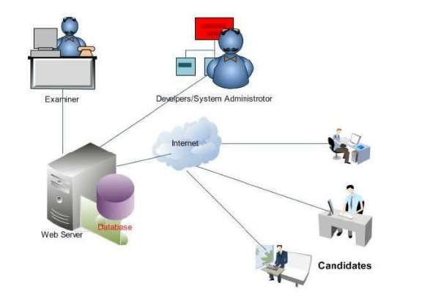
Proposed System
Fig of Proposed system

Slide 6
Proposed System
The online test created for taking online test has following features-
In comparison to the present system the proposed system will be less time consuming and is more efficient.
Result will be very precise and accurate and will be declared in very short span of time because calculation and evaluations are done by the simulator itself.
The proposed system is very secure as no chances of leakage of question paper as it is dependent on the administrator only.
The logs of appeared candidates and their marks are stored and can be backup for future use

Slide 7
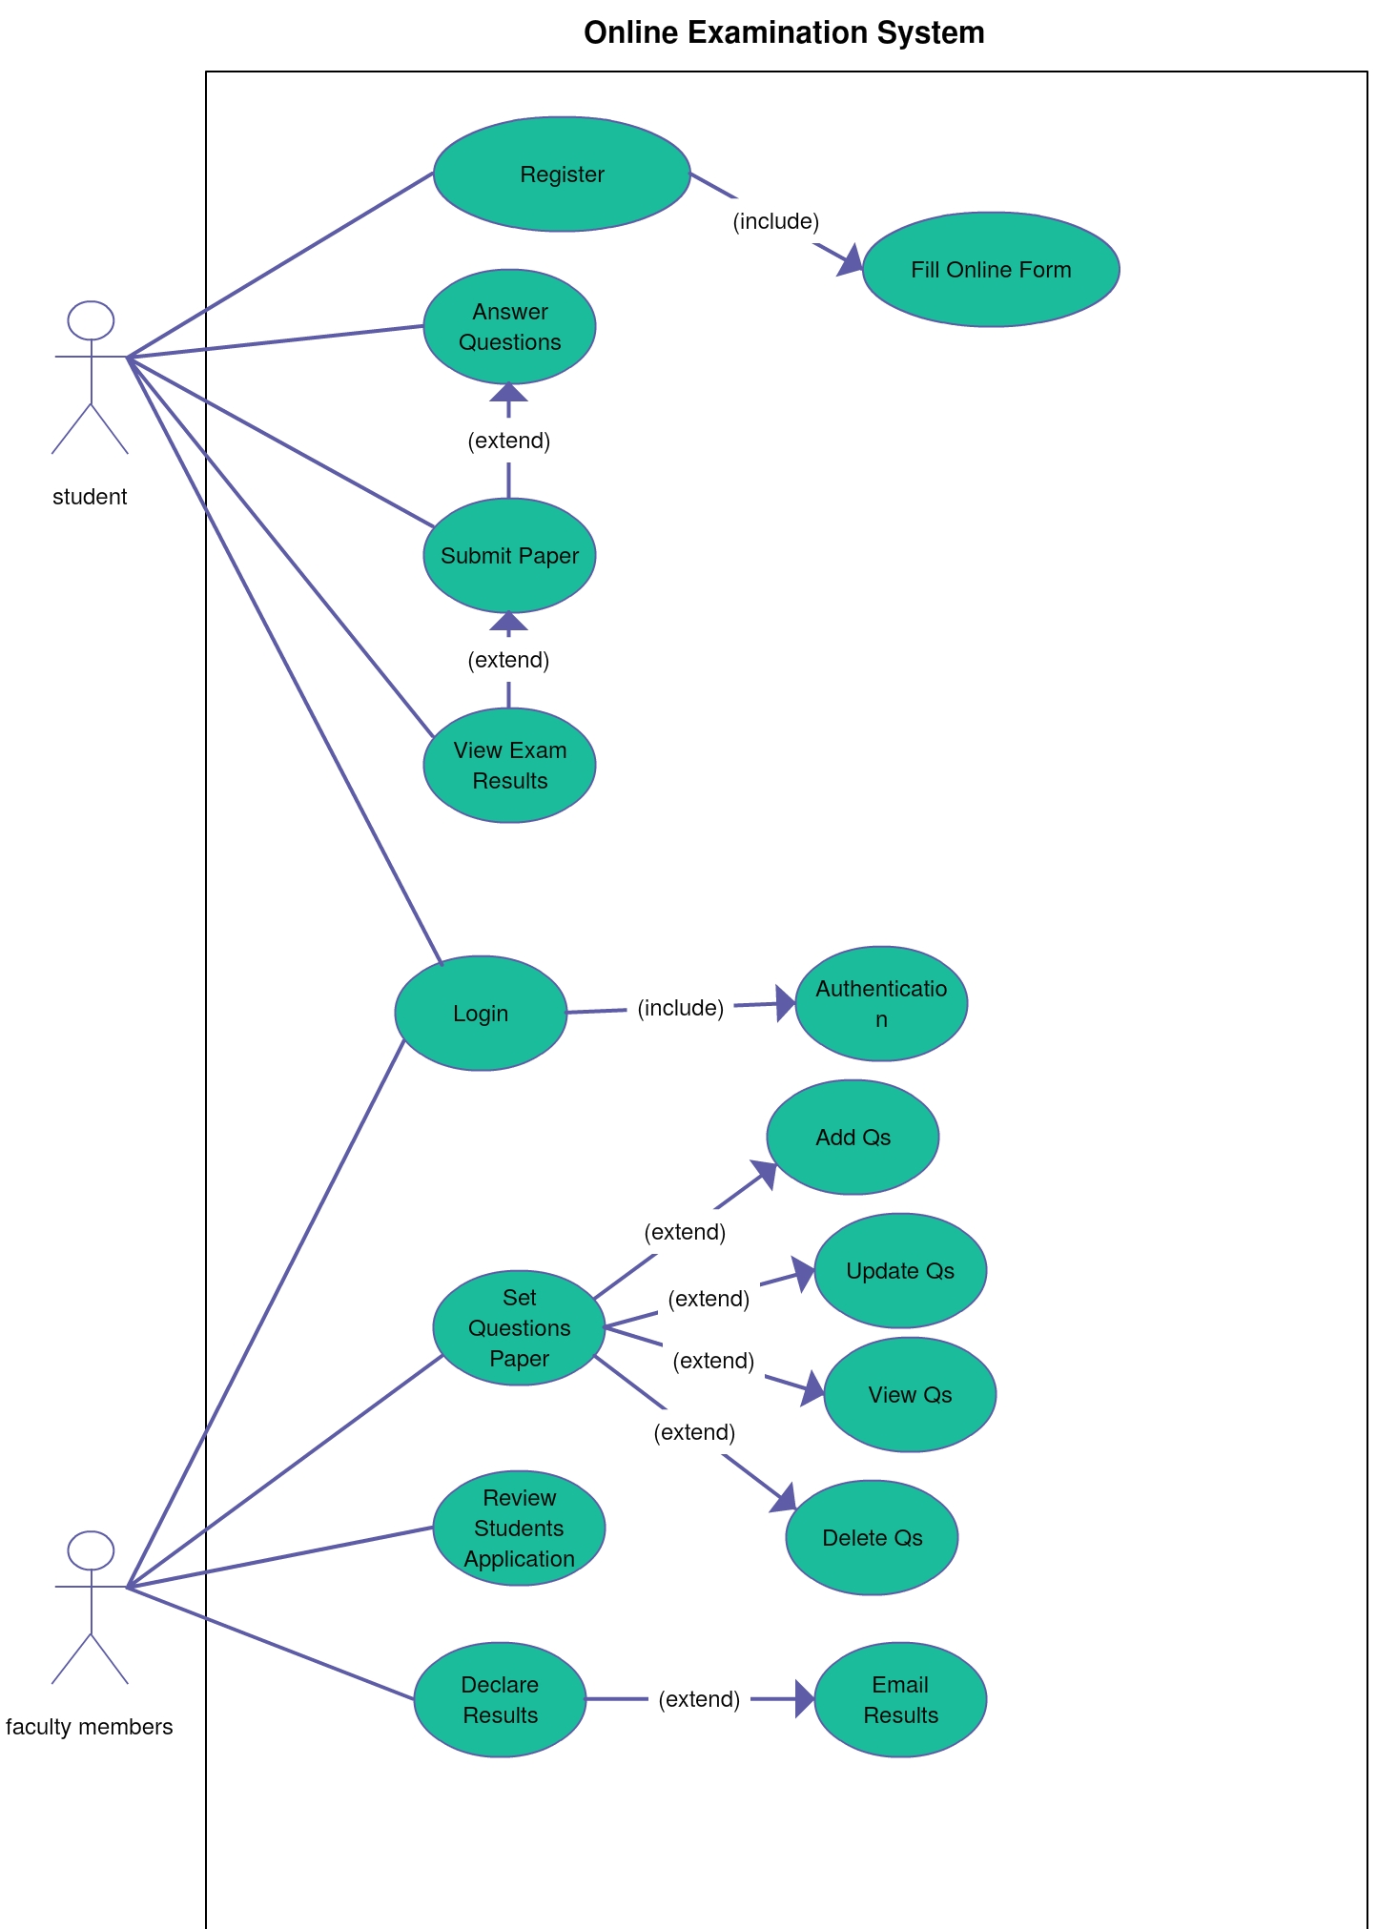
Use Case Diagram
Fig Use Case Diagram
Fig Use Case Diagram

Slide 8
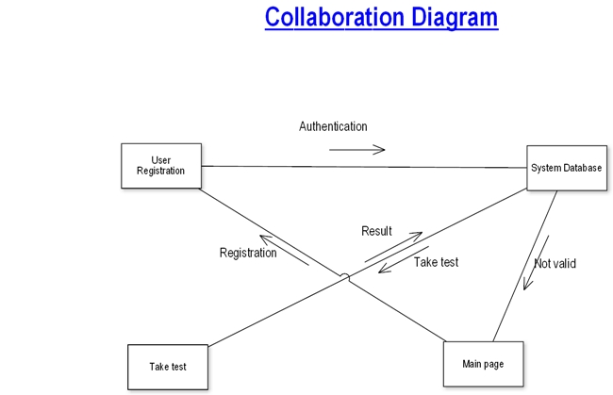
Fig Collaboration Diagram

Slide 9
Class Diagram
Fig Class Diagram

Slide 10
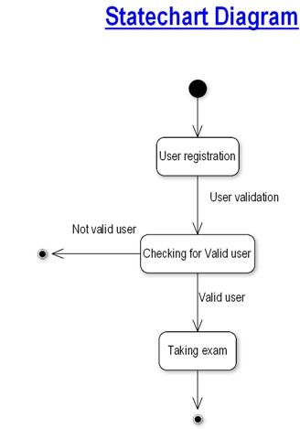
Fig State Chart Diagram

Slide 11
Software Requirements
Operating system
Windows XP and others
Browser
Internet Explorer and others
Front-End
HTML,CSS,JAVASCRIPT
Back-End:
MySQL
Web Server:
Apache SERVER.

Slide 12
Hardware Requirement
Pentium-IV(Processor).
256 MB Ram
512 KB Cache Memory
Hard disk 10 GB

Slide 13
Student Aspects
Requesting registration.
Logging into the system.
Selecting the test.
Appearing for the examination.
Printing the result at the end of the examination.
Check previous results.
Overall Performance
Reviewing the given responses.(or feedback)

Slide 14
Administrator Aspects
Taking backup of the database.
Editing/Deleting/Creating the database.
Changing the password.
Logging into the system.
Accepting registrations of candidates.
Deleting the registrations of candidates
Creating a test.
Posting questions in the above test.
Posting multiple options to respective question.
Marking correct answer within the given options.
Time limit of the test if any.
Whether to randomize the questions.
Set negative marks for wrong responses.

Slide 15
Scope
Scope of this project is very broad in terms of other manually taking exams Few of them are:-
This can be used in educational institutions as well as in corporate world.
Can be used anywhere any time as it is a web based application(user Location doesn’t matter).
No restriction that examiner has to be present when the candidate takes the test.
Design to facilitate Administrator and User
Online examination is designed for educational institutes like Schools ,colleges and private institutes to conduct logic tests of their students or employees on regular basis

Slide 16
Advantages Of OES
Physical presence at a given location is absolutely not necessary
No time is spent on evaluation
Results are available instantly
Can be easily accessed 24/7 over the open test period
Can be timed to allow Y minutes to answer X number of questions
Easy Accessibility.
Available at a reduced cost.
Accuracy in checking the answer, calculating result.
User friendly.
Secure because of authentication .
Online exams - Convenience, security and flexibility.
Exams can be assembled and previewed, edited and published instantly.

Slide 17
Conclusions
Online Examination System (OES) is a web application.
The key concept is to minimize the amount of paper and convert all forms of documentation to digital form.
It can observe that the information required can be obtained with ease and accuracy in the computerized system.
The user with minimum knowledge about computer can be able operate the system easily.
The system also produces brief result required by the management.

Slide 18
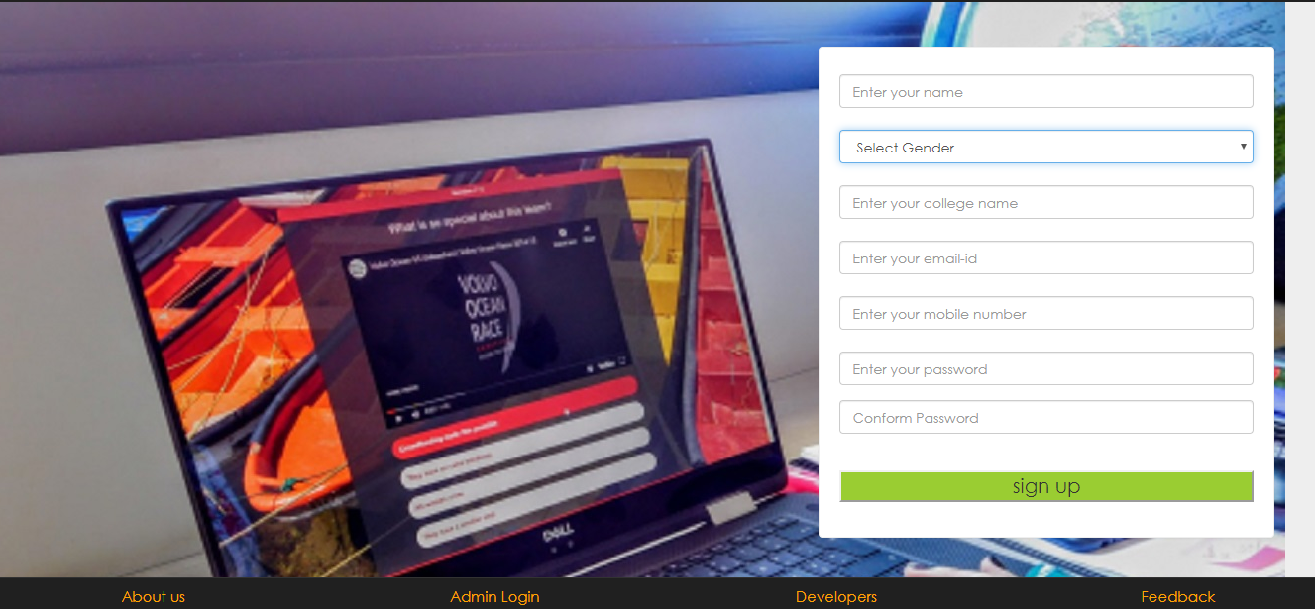
Some Attachments
User Registration
Fig Registration of Users

Slide 19
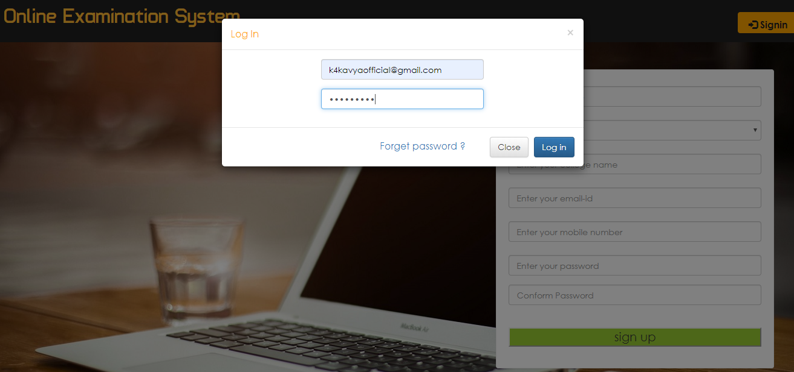
User Login

Slide 20
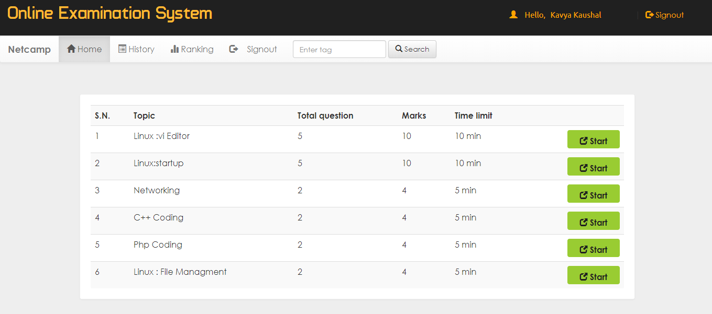
Test Page
Fig- Tests on following modules with a given period of time

Slide 21
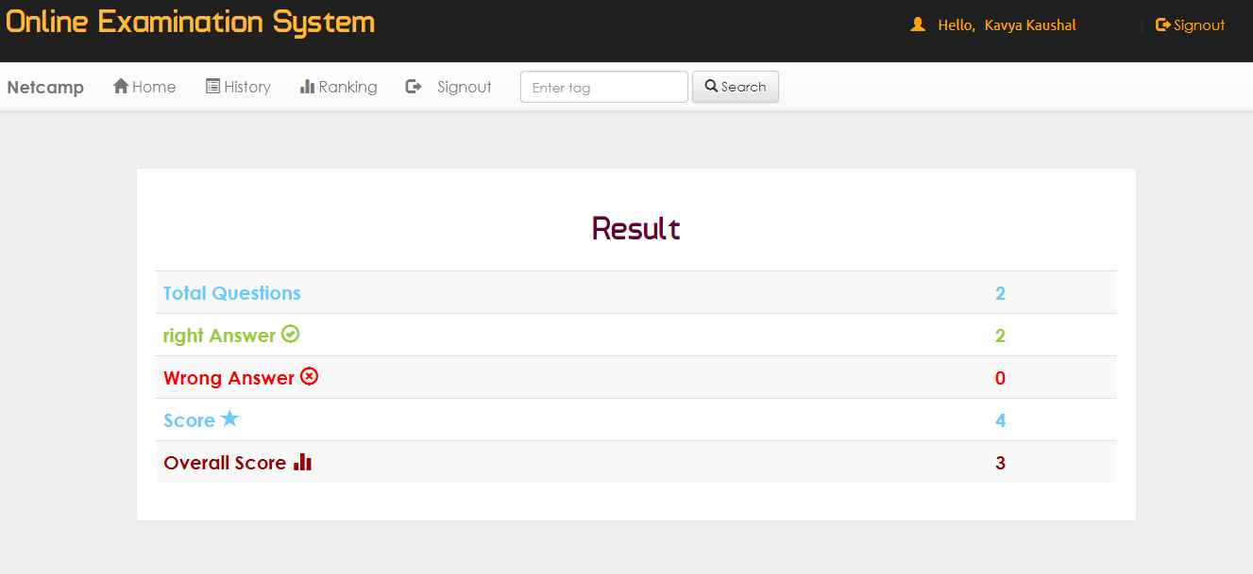
Result
Fig Users Can See their Score

Slide 22
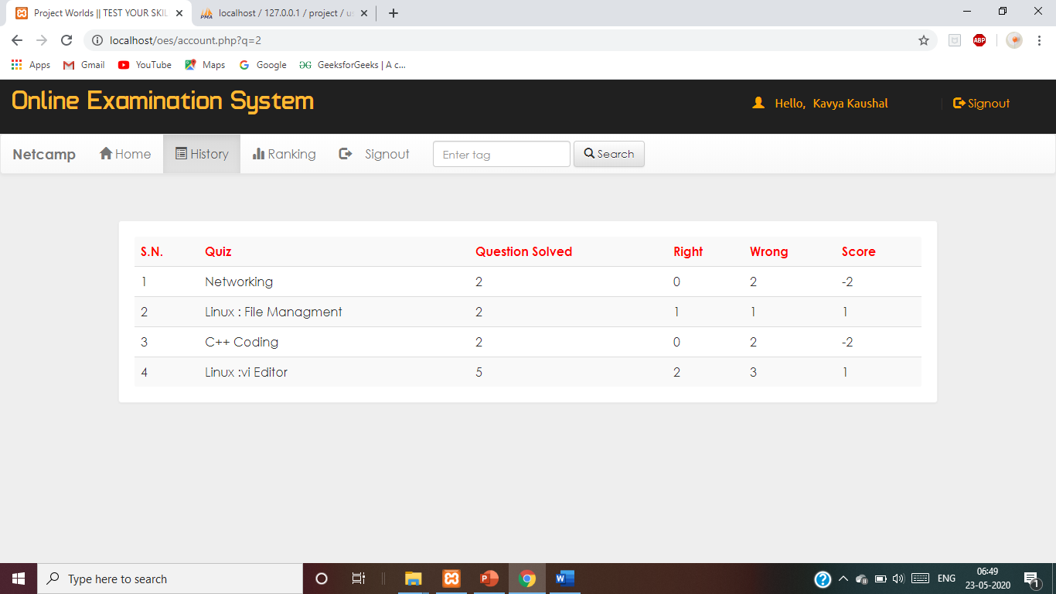
Result History
Fig user can see its tests results

Slide 23
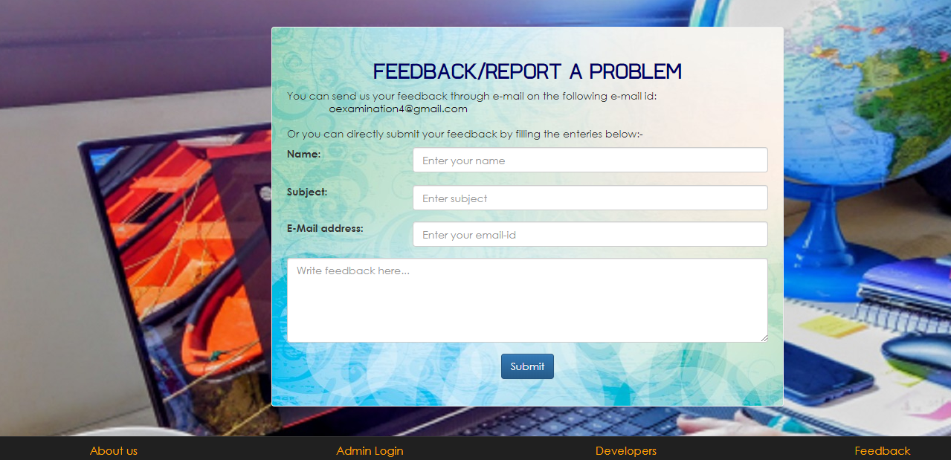
Feedbacks Of Users
Fig Feedback Form

Slide 24
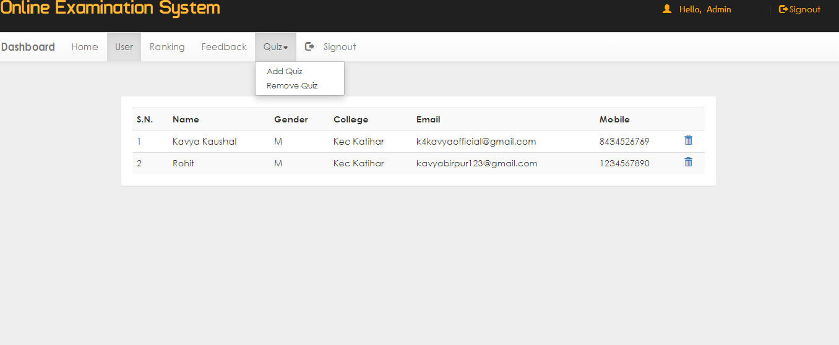
Admin Section
Fig Admin can see Users Info , delete the users add or remove the quiz

Slide 25
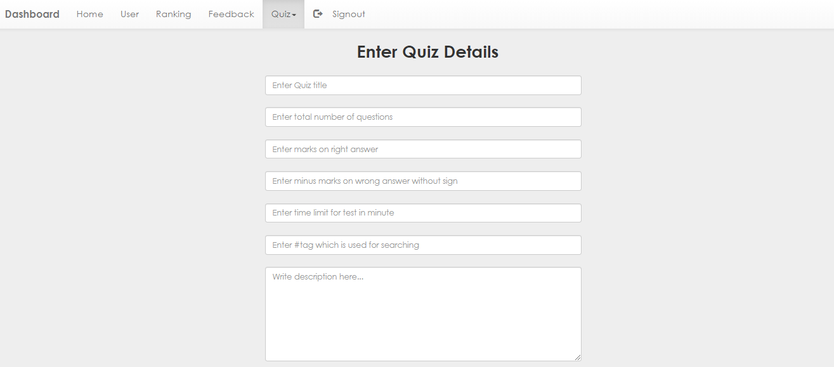
Add the Quiz
Fig Admin can Add the Quizs with specific period of time

Slide 26
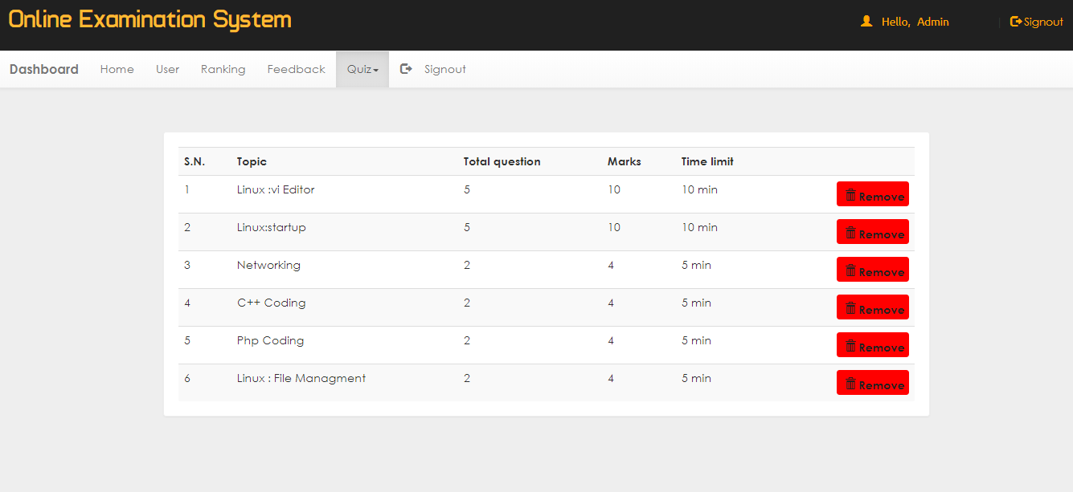
Remove The Quiz
Fig Add Or delelte the quizs

Slide 27
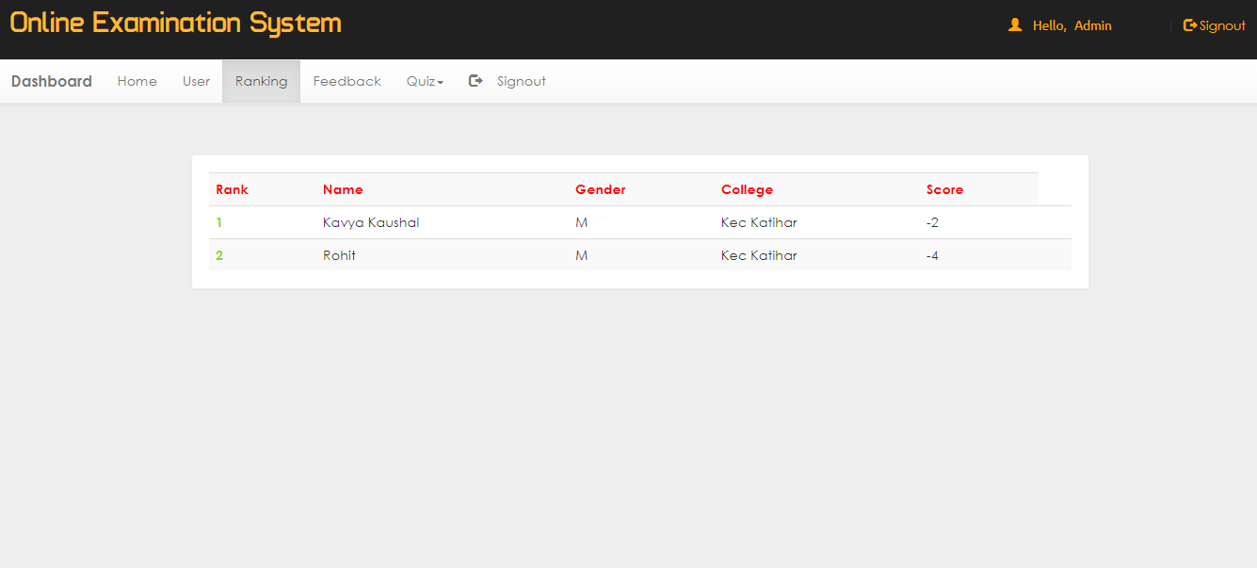
Users Ranking
Fig Admin can see the actual ranking Of all the Users

Slide 28
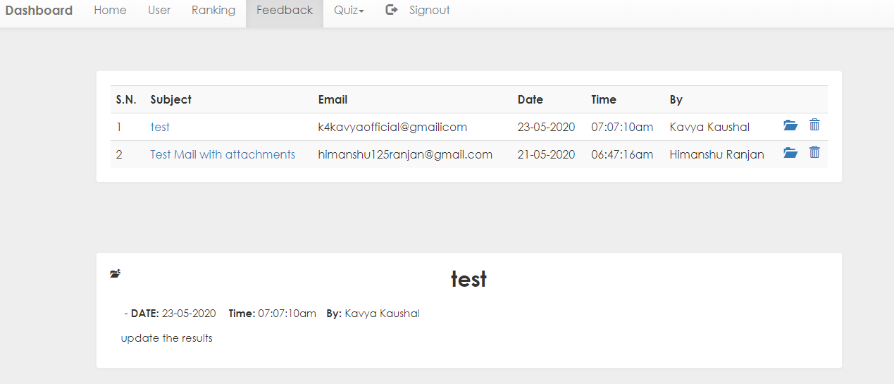
Feedback
Fig admin can see the feedback of users

Slide 29
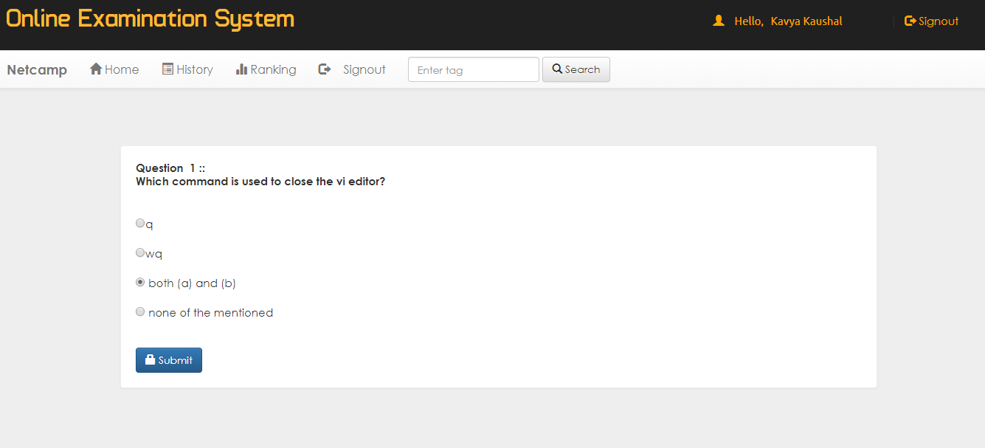
Questions
Fig User Can attempt or pass the Questions

Slide 30
The end
Thank you !!!

